Slide 1
AIRFRAME TEAM N-2 ROCKET WEEK2
PRESENTATION BY:
MARK ODHIAMBO &
VIVIAN MWANGI

Slide 2
DESIGN
We did cradle design
purpose of the cradle:
used for the fabrication of the body tubes
Material to be used:
wood for the frame support
Hollow pipe(body tubes)

Slide 3
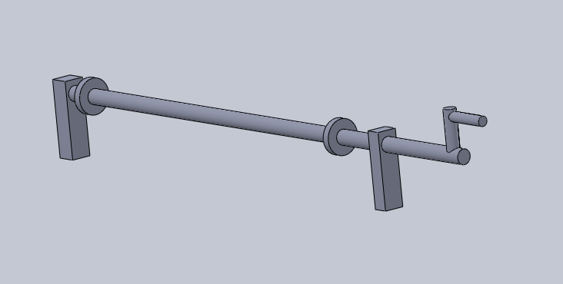
Pictorial from Solidworks

Slide 4
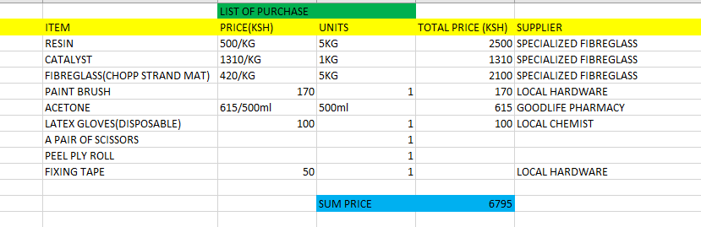
RESEARCH
ON SUPPLIERS OF VARIOUS MATERIALS SELECTED & COST ANALYSIS
Below is the list of purchase:

Slide 5
DESIGN2: ROCKET
We determined the design parameters by gathering information from other groups.
We made a rocket design on the open rocket software

Slide 6
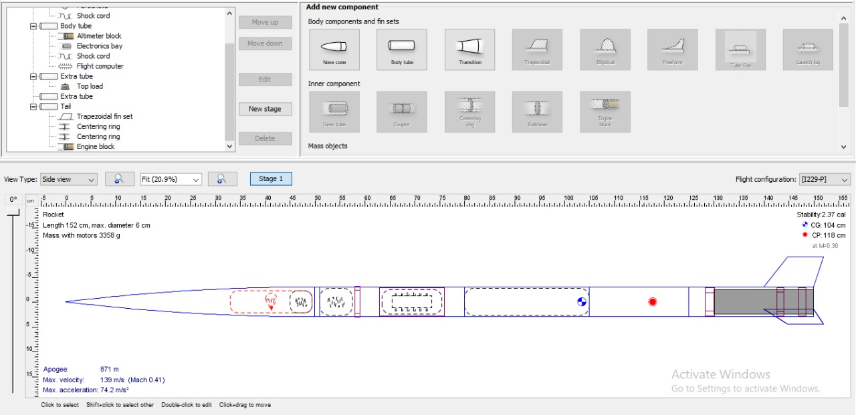
Pictorial from open rocket

Slide 7
Tasks completed this week
Cradle design [Github issue#39]
Rocket design and simulation [Github issue#38]
Material selection and analysis[Github issue#37]

Slide 8
Tasks in this week
Cradle Fabrication [Github issue#58]
CAD Design [Github issue#59]
Purchase of materials [Github issue#60]

Slide 9
TIME PLAN.
WEEK 1-material SELECTION, ANALYSIS AND COST
WEEK 2-DESIGN AND SIMULATION.
WEEK 3-SIMULATION CORRECTIONS.
WEEK 4-RECOVERY SYSTEM.
WEEK 5-ASSEMBLY AND FABRICATION.
WEEK 6-ASSEMBLY AND FABRICATION.
WEEK 7-FINALISATION.
WEEK 8-TAKE OFF.
PRONE TO CHANGE AS PER THE SITUATION.

Slide 10
THE END.
THANK YOU.

